Slide 1
FinHeartBel
Marko, Nathan & Mo

Slide 2

EDIT IN GOOGLE SLIDES
Click on the button under the presentation preview that says "Use as Google Slides Theme".
You will get a copy of this document on your Google Drive and will be able to edit, add or delete slides.
You have to be signed in to your Google account.
EDIT IN POWERPOINT®
Click on the button under the presentation preview that says "Download as PowerPoint template". You will get a .pptx file that you can edit in PowerPoint.
Remember to download and install the fonts used in this presentation (you’ll find the links to the font files needed in the Presentation design slide)
More info on how to use this template at www.slidescarnival.com/help-use-presentation-template
This template is free to use under Creative Commons Attribution license. You can keep the Credits slide or mention SlidesCarnival and other resources used in a slide footer.

Slide 3

Shocking Facts all around the world
1 out of 18 has Cardiac Arrhythmia worldwide.
Cardiovascular diseases are the leading cause of death in the EU.
(2013 = 37,5%)
Heart disease is the number 1 death cause in Russia.
Approximately 500.000 Americans die every year from a heart disease, Cardiac Arrhythmia causes the majority of that.
18% of all deaths in South Africa are cause by Cardiovascular diseases.

Slide 4
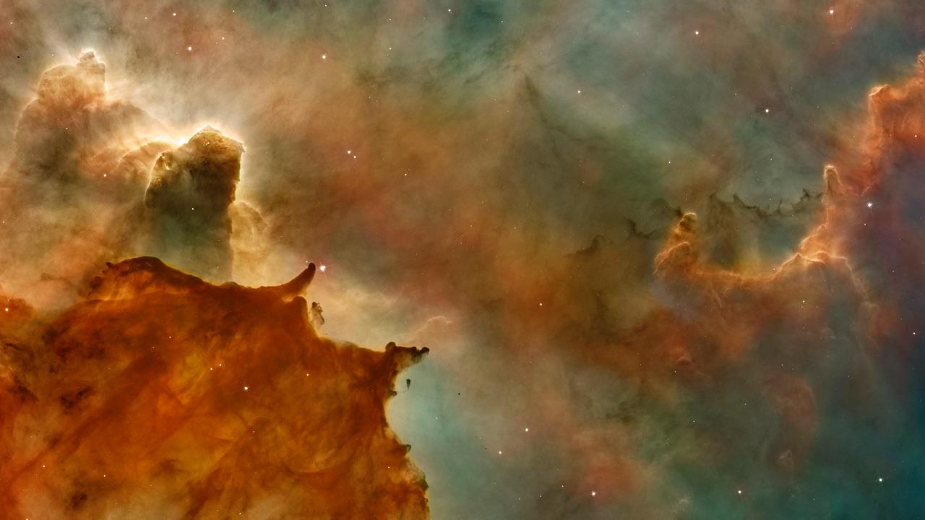
The Idea
Inform people in advance and offer them a simple solution. Keeping track of their health with FinHeartBel.

Slide 5
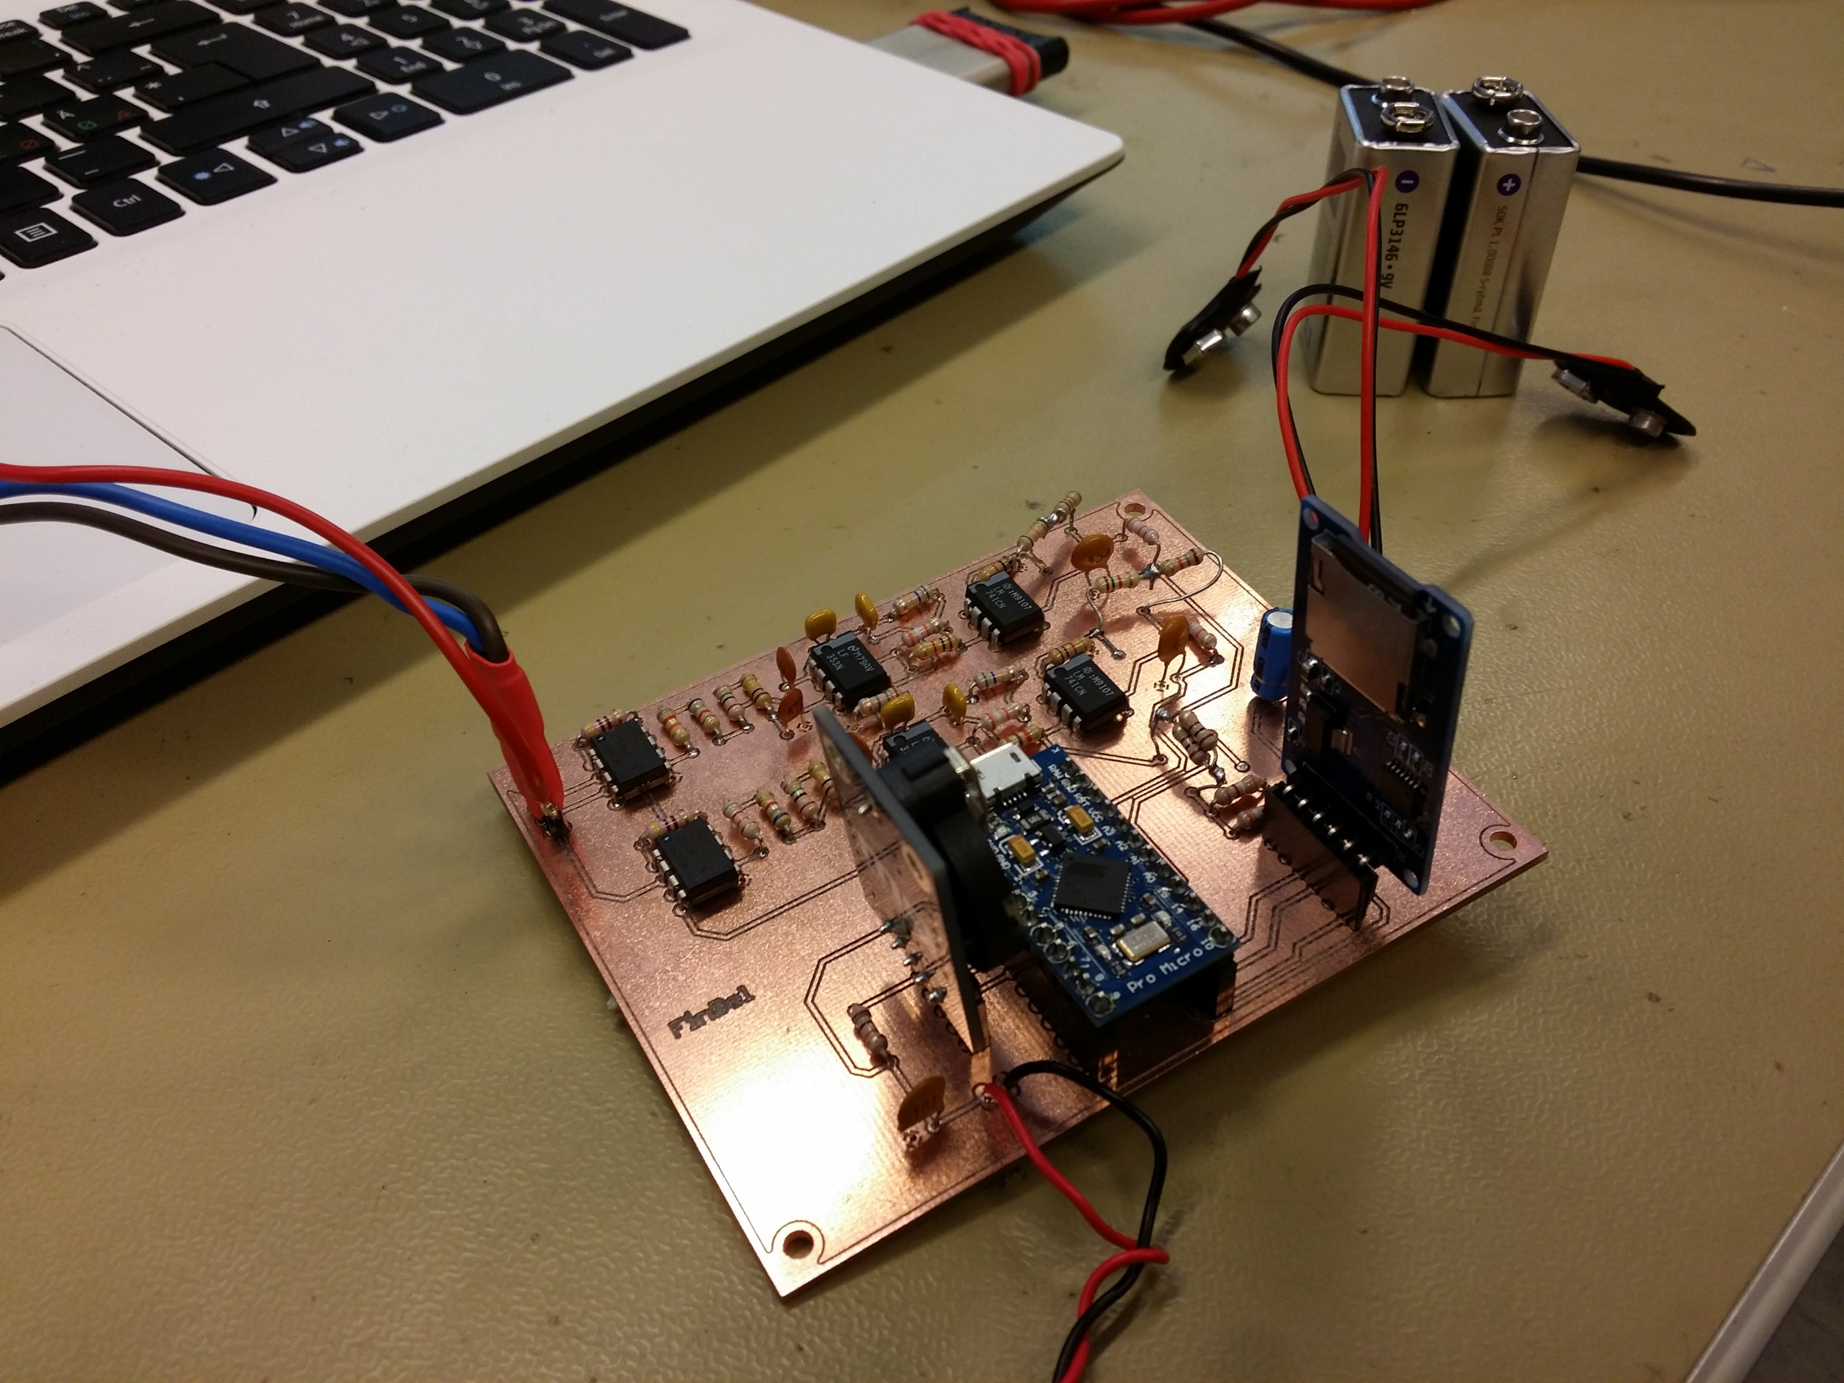
Hardware
Amplifier
Filter
Raise of voltage level
RC filter
A/D conversion
SD card

Slide 6
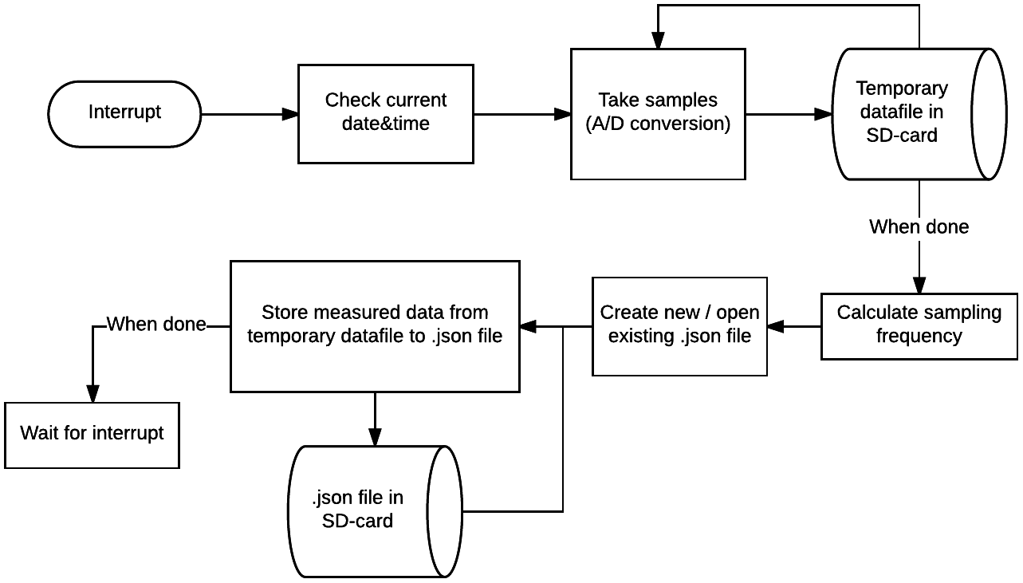

Slide 7
OUR PROCESS IS EASY
Measurements with device
Analyze with our algorithm
Diagnose online

Slide 8

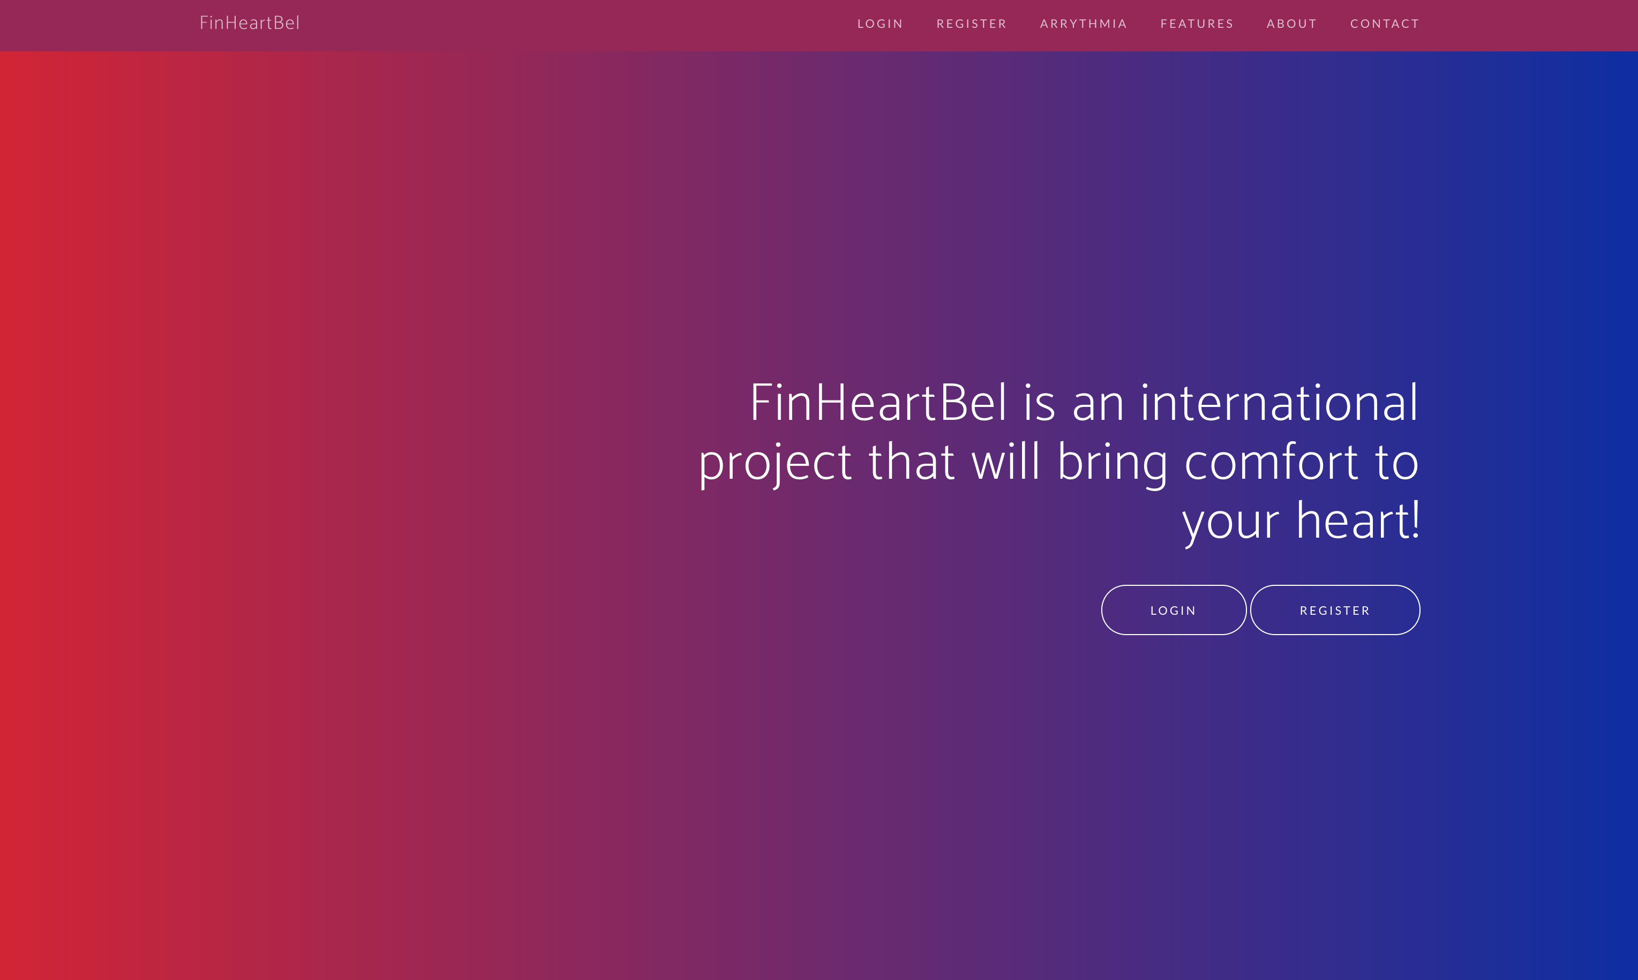
FinHeartBel
Place your screenshot here
Demonstration

Slide 9
OUR PROCESS IS EASY
Measurements with device
Analyze with our algorithm
Diagnose online

Slide 10

ALGORITHM
ECG
Linear highpass filter
Non-linear lowpass filter
Decision making
BPM

Slide 11
Algorithm
Custom C to Typescript port
Client-based implementation
Frequency independant
Portable to other projects and devices
Implementation of HC Chen, SW Chen, University of Taiwain
Algorithm based on Pan-Tompkins 1982

Slide 12
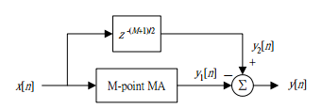
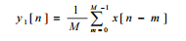
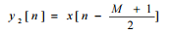
Highpass linear regression
moving average filter
Filter noise from Arduino
Preparing stage for lowpass filter

Slide 13
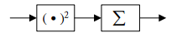
Lowpass stage
Emphisize peaks
Squaring function

Slide 14
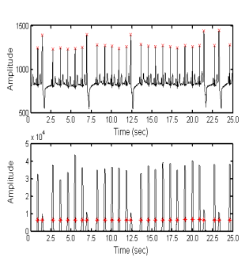
Decisionmaking stage
Detecting peaks
Frequency independant
Arrythmia decision making
BPM Calculation

Slide 15

LET’S REVIEW SOME CONCEPTS
Yellow
Is the color of gold, butter and ripe lemons. In the spectrum of visible light, yellow is found between green and orange.
Blue
Is the colour of the clear sky and the deep sea. It is located between violet and green on the optical spectrum.
Red
Is the color of blood, and because of this it has historically been associated with sacrifice, danger and courage.
Yellow
Is the color of gold, butter and ripe lemons. In the spectrum of visible light, yellow is found between green and orange.
Blue
Is the colour of the clear sky and the deep sea. It is located between violet and green on the optical spectrum.
Red
Is the color of blood, and because of this it has historically been associated with sacrifice, danger and courage.

Slide 16
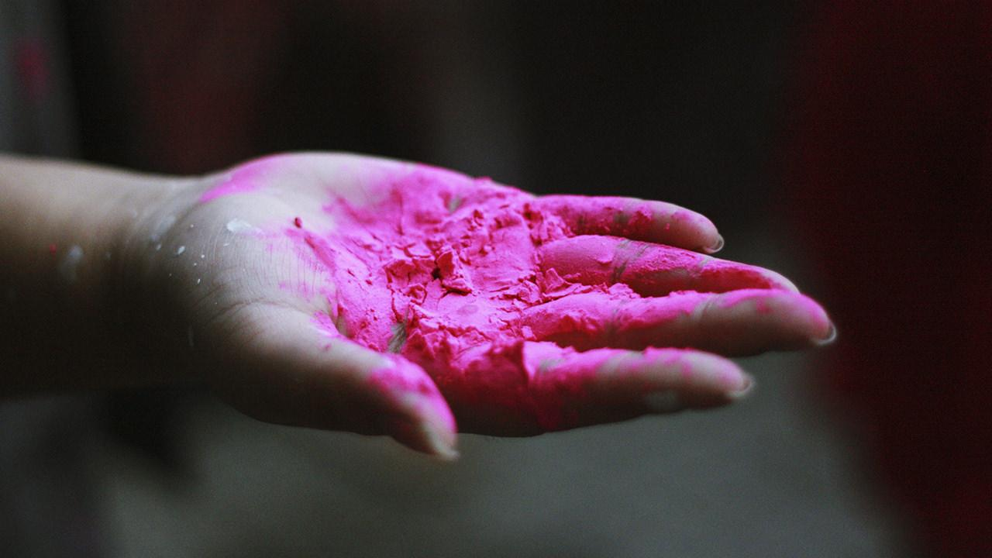
THANKS!
Any questions?
You can contact us:
nathan.aertgeerts@student.ap.be
mo.bouzim@student.ap.be
t5ylma01@students.oamk.fi

Slide 17

CREDITS
Special thanks to all the people who helped making this possible:
Tom & Luc Peeters
Pekka Alaluukas & Jaakko Kaski
Marko & Veli-Pekka, Nathan & Mo

